Slide 1
Group 5 : Loss monitoring
Me, Anton, Pranav, Craig, Evelyn
RAL Visitor Centre
07.07.23

Slide 2

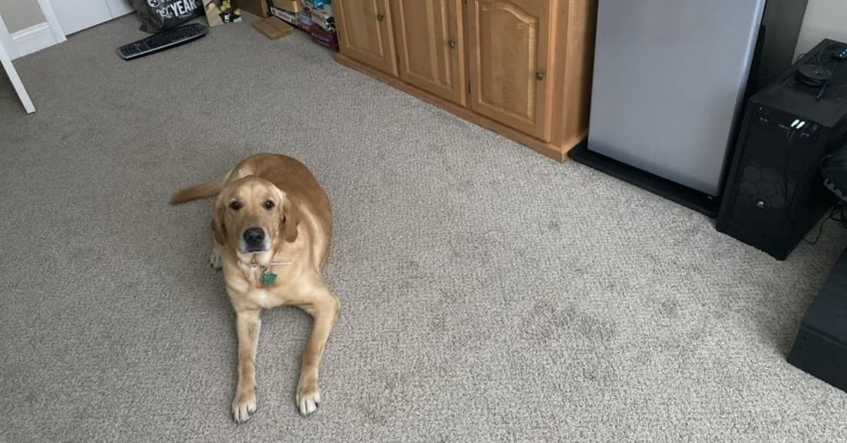
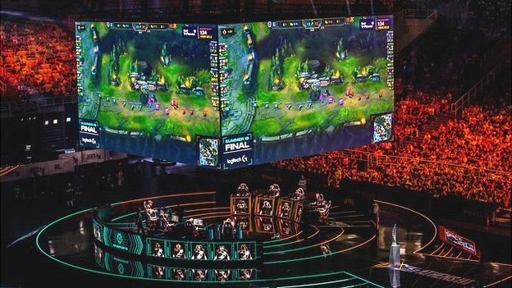
My personal introduction

Slide 3
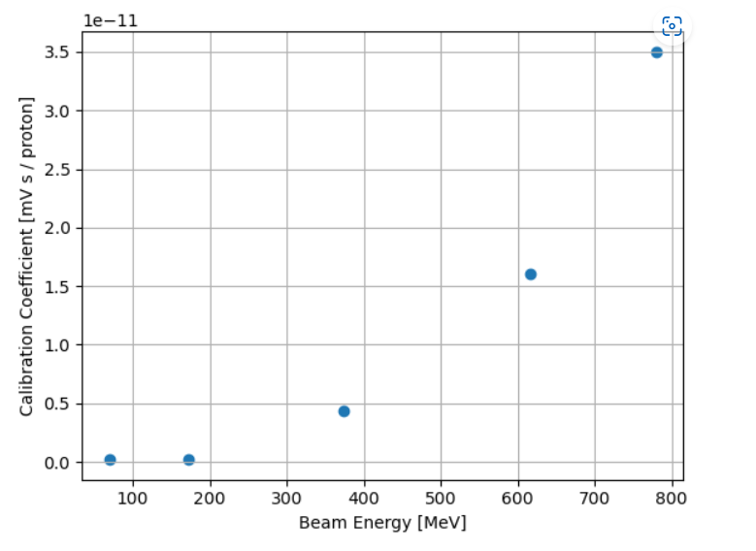
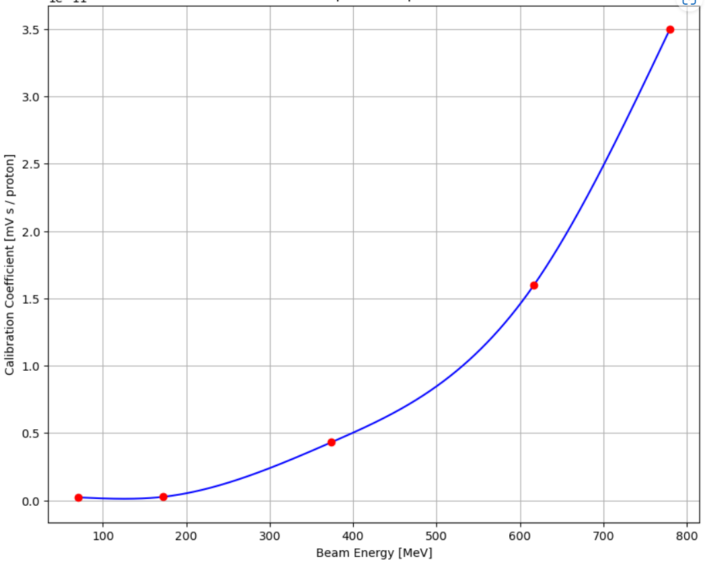
Stage 1 Projects: Group 1F: Interpolation

Slide 4
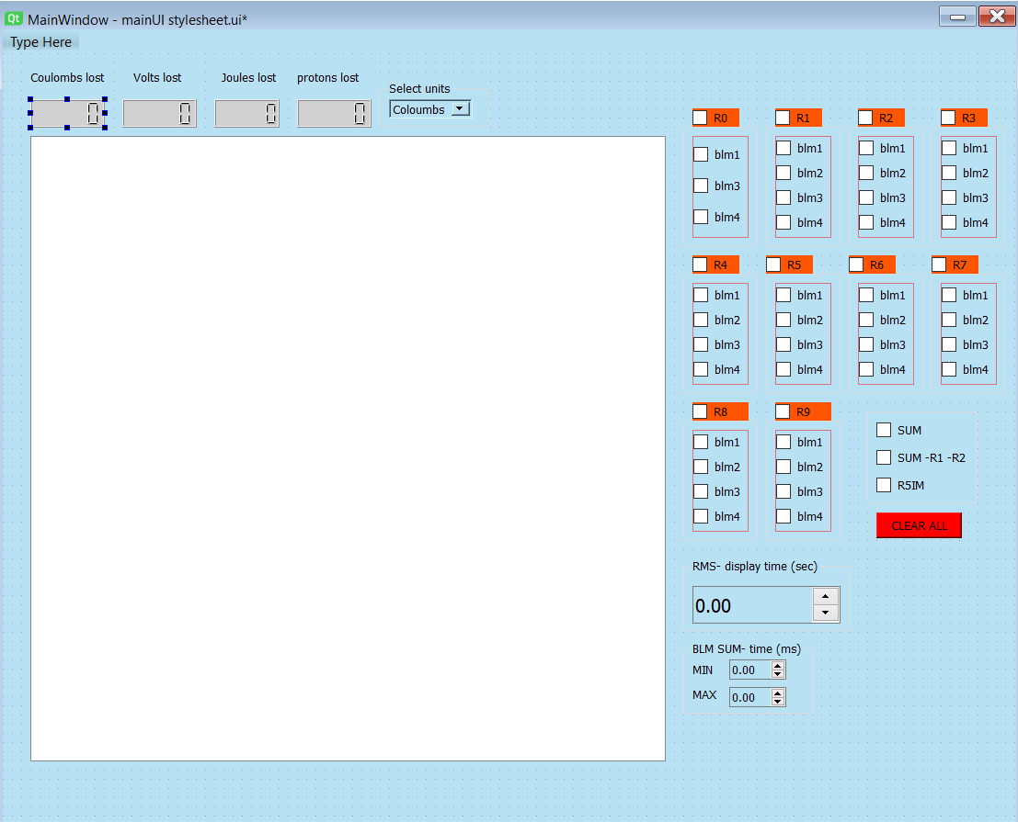
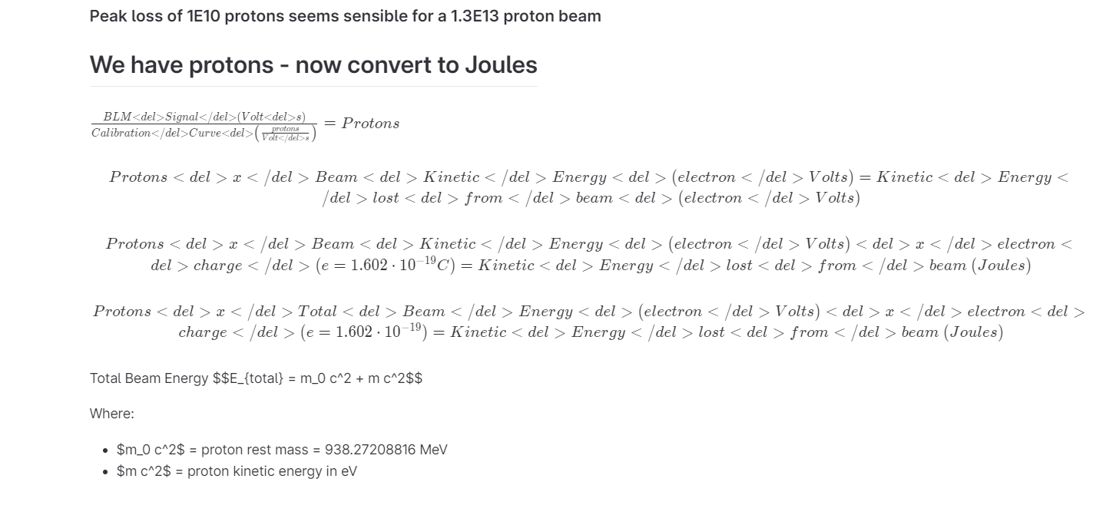
Stage 2 Projects: Waterfall GUI

Slide 5
Each human should take a copy of this template, and fill in the above 3 slides
Each human should rename this template to their first name and save it
One human from each GUI group collect these templates and put them together (open 2 powerpoint instances and copy/paste the slides from the left menu), edit the title slide, acknowledgements, etc

Slide 6
Acknowledgments
We are privileged to do a job that we love, and one that serves so many. In order to do big science we require vast teams and incredible people who support our work. We must always acknowledge those who contribute to our success.
Our cleaner Pamela sanitises every desk in the building, vacuums our biscuit crumbs, mops the floors, disposes of our cups and napkins, carries our refuse to the industrial bins, ensures we have clean toilets, and often moves furniture, every day before we arrive.
Our reception team have had to phone a grumpy physicist on every occasion that you forgot your badges, and often I’ve missed their calls so they’ve sorted you out anyway. That’s a lot of unnecessary hassle for them.
Our public engagement (PE) team have read ~ 700 wx applications, sifted and sorted your applications, so that we could select you individually. All other wx students have a desk wherever their supervisor can find space. The PE team have not only granted us their space for 2 weeks, but the use of their laptops. We have exceptionally been granted use of their personal kitchen.
Please delete the above message and keep it simple:
Public Engagement Team
Etc

Slide 7
GUI Demo
5 minutes max, show live data, demo mode, change some settings and show features

Slide 8
Thank you
Questions?

